Slide 1
Section 3.5
Graphing Techniques;
Transformations
Copyright © 2012 Pearson Education, Inc. Publishing as Prentice Hall.

Slide 2
Copyright © 2012 Pearson Education, Inc. Publishing as Prentice Hall.

Slide 3

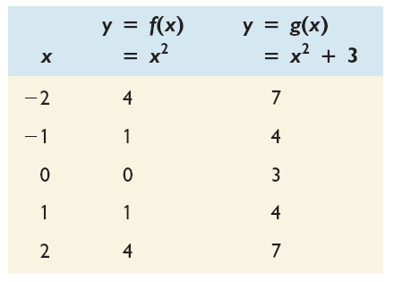
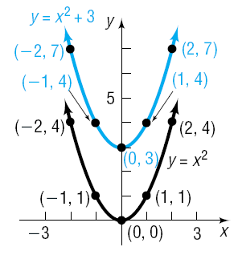
Copyright © 2012 Pearson Education, Inc. Publishing as Prentice Hall.

Slide 4
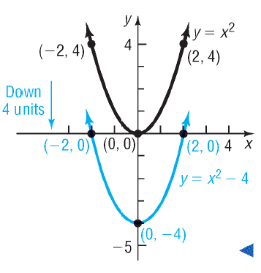
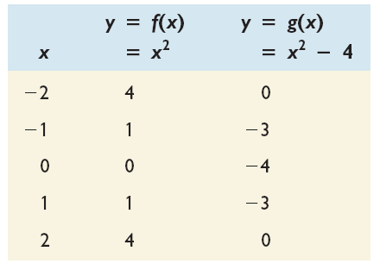
Copyright © 2012 Pearson Education, Inc. Publishing as Prentice Hall.

Slide 5

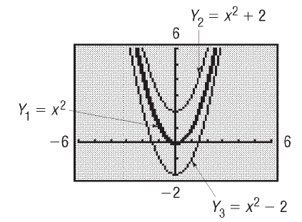
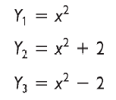
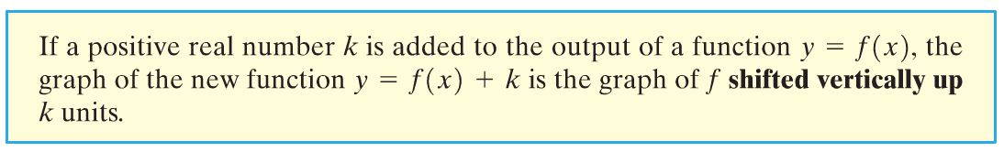
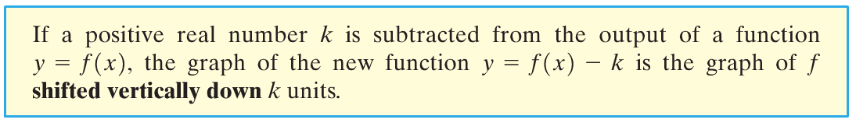
Copyright © 2012 Pearson Education, Inc. Publishing as Prentice Hall.

Slide 6
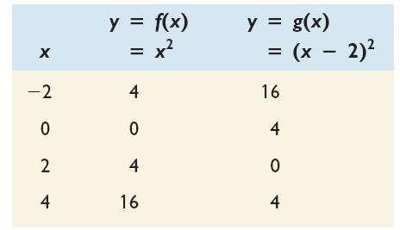
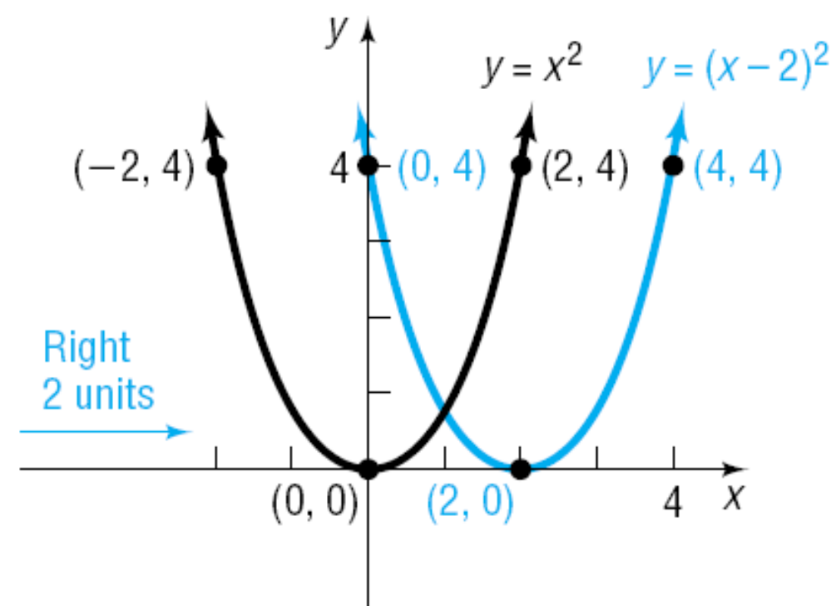
Copyright © 2012 Pearson Education, Inc. Publishing as Prentice Hall.

Slide 7

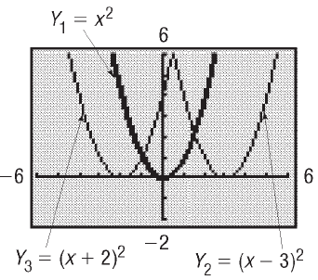
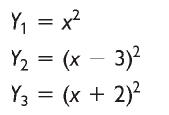
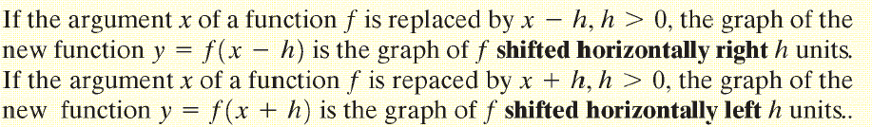
Copyright © 2012 Pearson Education, Inc. Publishing as Prentice Hall.

Slide 8
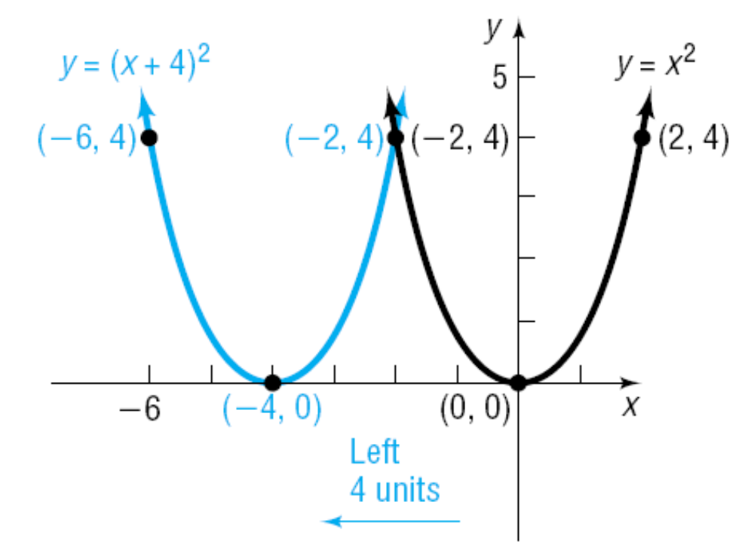
Copyright © 2012 Pearson Education, Inc. Publishing as Prentice Hall.

Slide 9
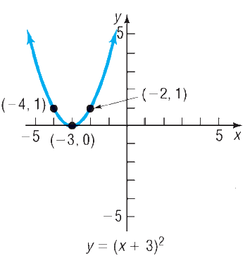
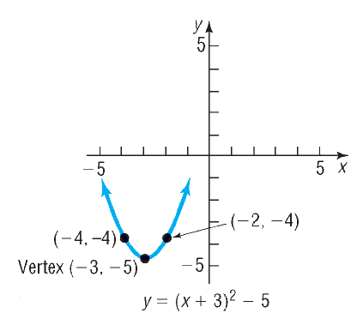
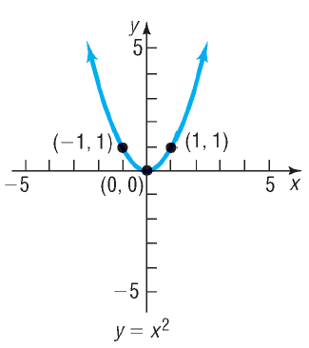
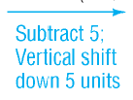
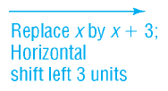
Copyright © 2012 Pearson Education, Inc. Publishing as Prentice Hall.

Slide 10
Copyright © 2012 Pearson Education, Inc. Publishing as Prentice Hall.

Slide 11
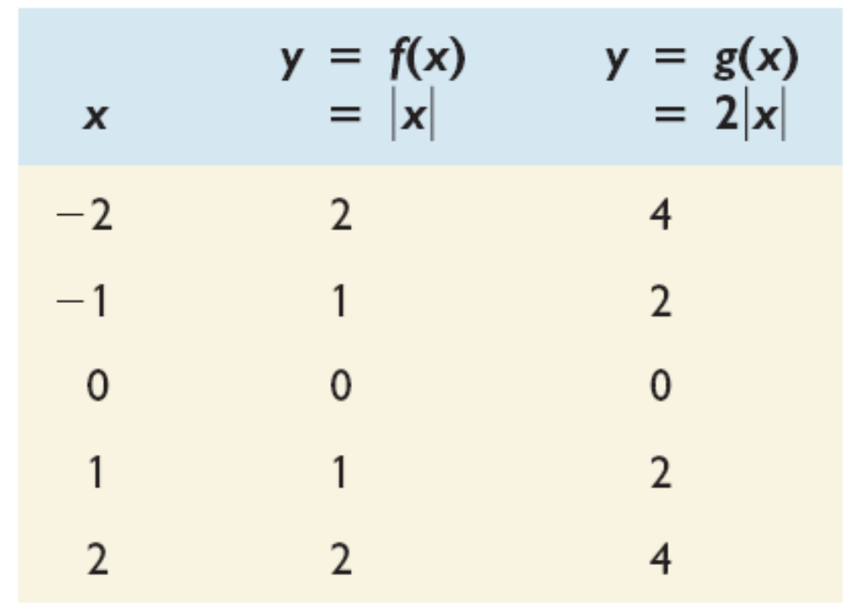
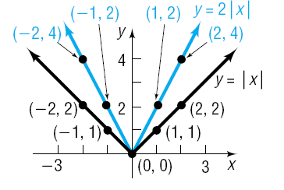
Copyright © 2012 Pearson Education, Inc. Publishing as Prentice Hall.

Slide 12
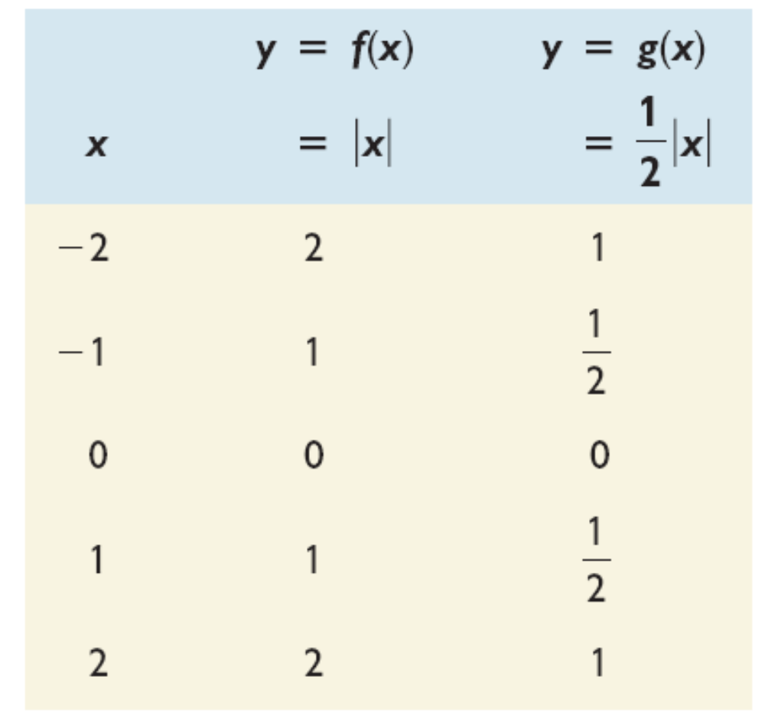
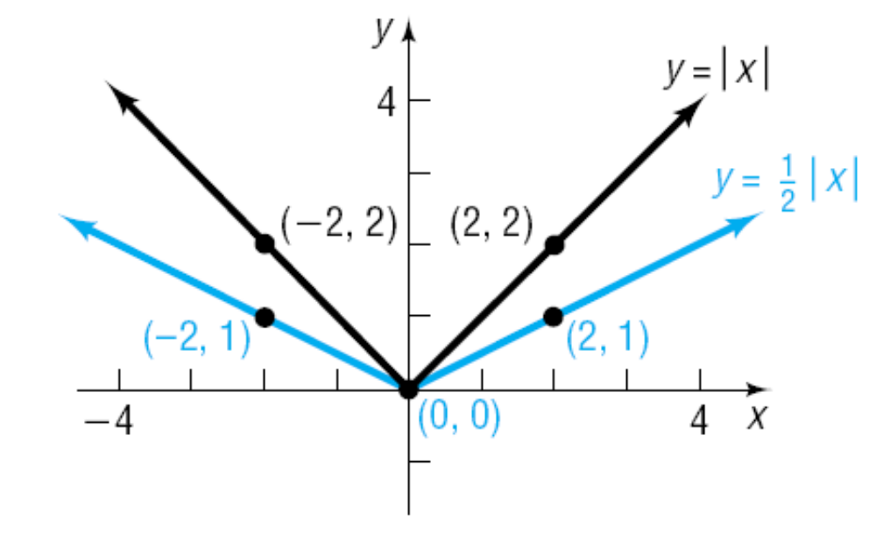
Copyright © 2012 Pearson Education, Inc. Publishing as Prentice Hall.

Slide 13
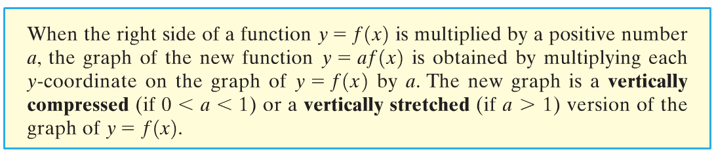
Copyright © 2012 Pearson Education, Inc. Publishing as Prentice Hall.

Slide 14

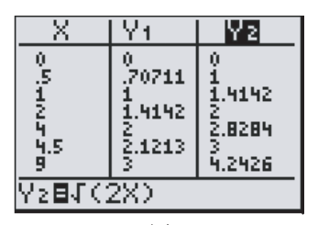
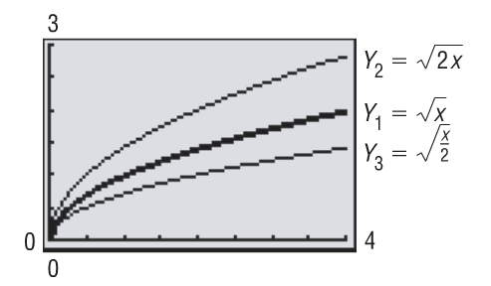
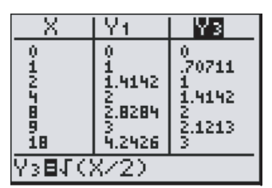
Copyright © 2012 Pearson Education, Inc. Publishing as Prentice Hall.

Slide 15
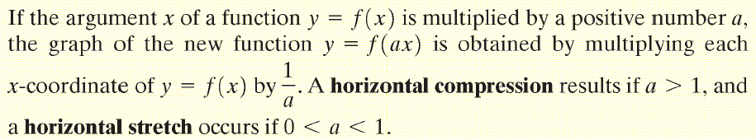
Copyright © 2012 Pearson Education, Inc. Publishing as Prentice Hall.

Slide 16
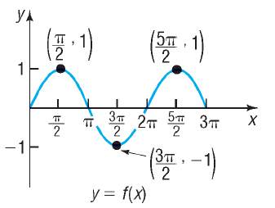

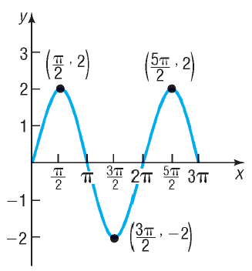
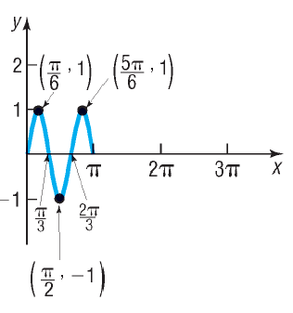
Copyright © 2012 Pearson Education, Inc. Publishing as Prentice Hall.

Slide 17
Copyright © 2012 Pearson Education, Inc. Publishing as Prentice Hall.

Slide 18
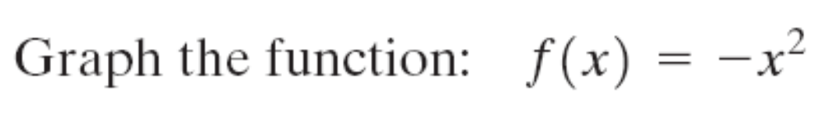
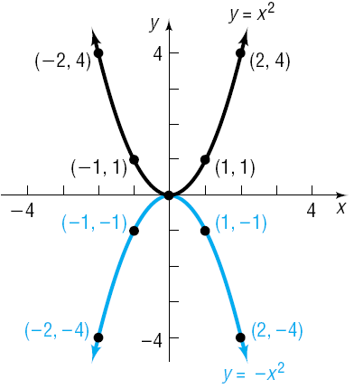
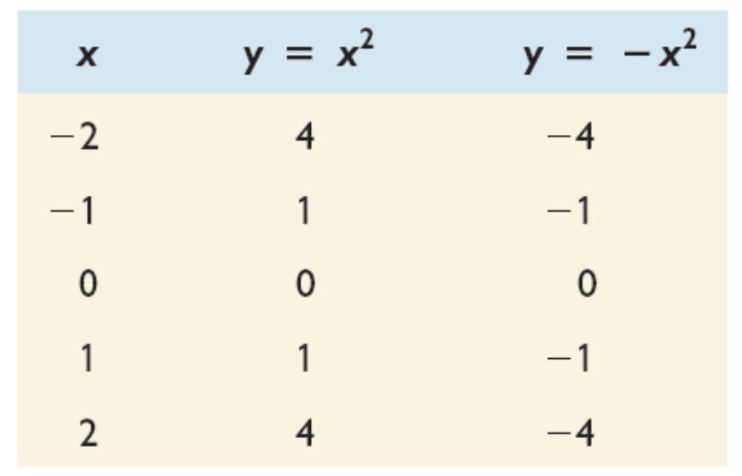
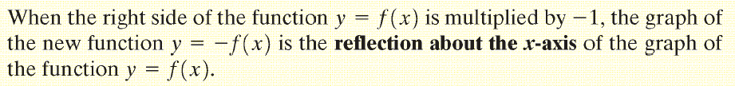
Copyright © 2012 Pearson Education, Inc. Publishing as Prentice Hall.

Slide 19
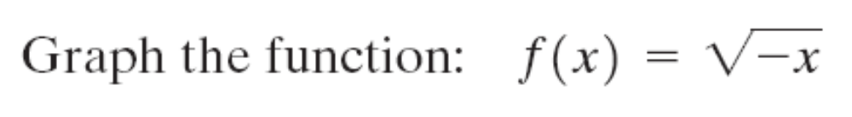
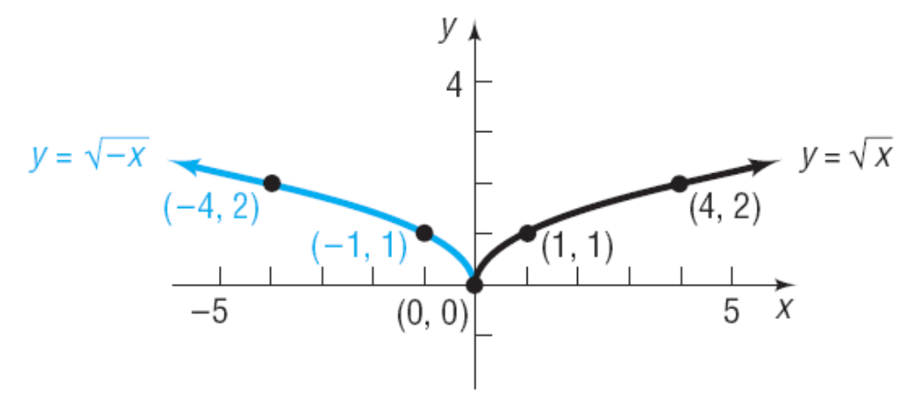
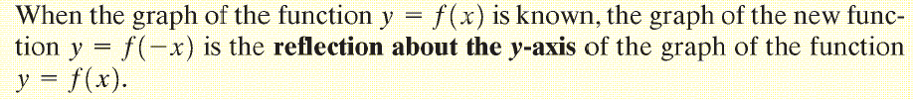
Copyright © 2012 Pearson Education, Inc. Publishing as Prentice Hall.

Slide 20
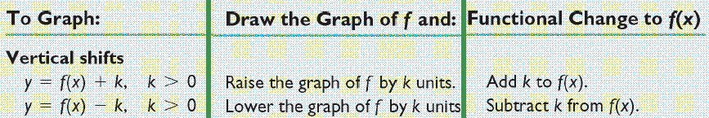

Copyright © 2012 Pearson Education, Inc. Publishing as Prentice Hall.

Slide 21
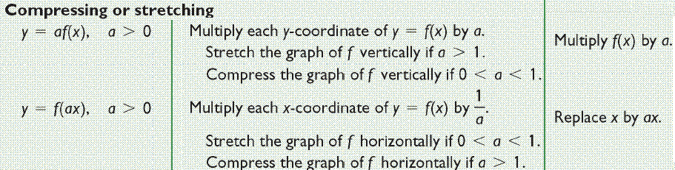
Copyright © 2012 Pearson Education, Inc. Publishing as Prentice Hall.

Slide 22
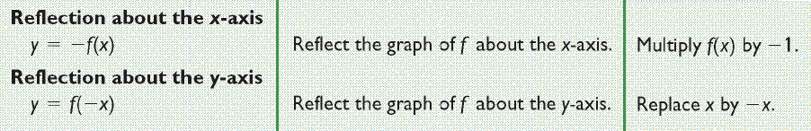
Copyright © 2012 Pearson Education, Inc. Publishing as Prentice Hall.

Slide 23
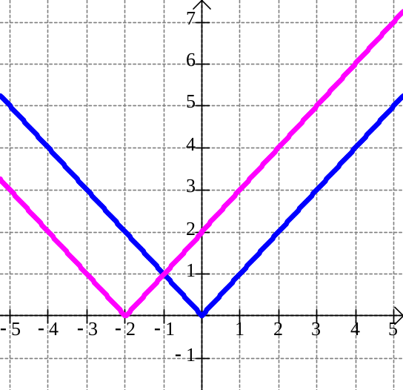
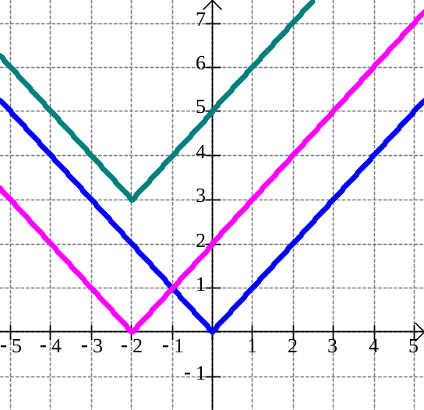
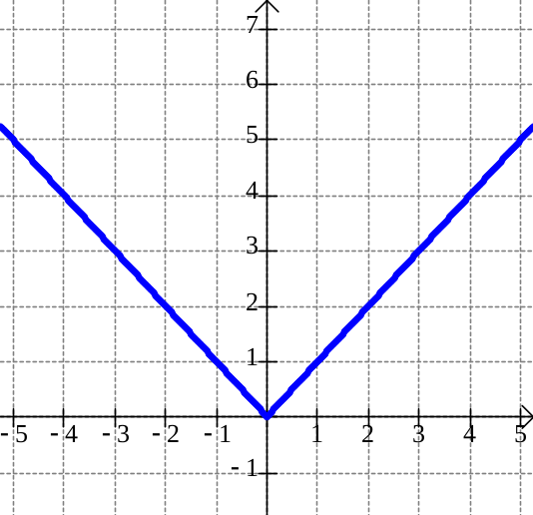
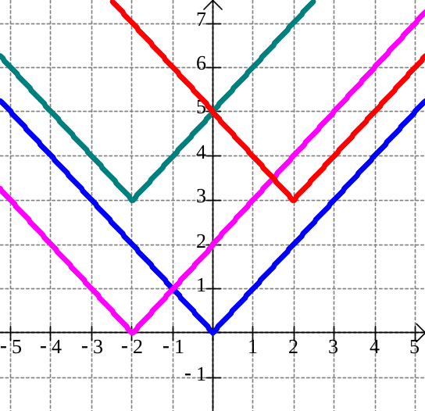
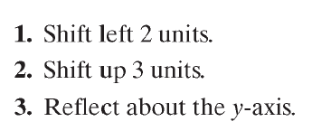
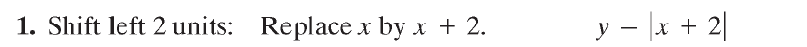
Copyright © 2012 Pearson Education, Inc. Publishing as Prentice Hall.

Slide 24

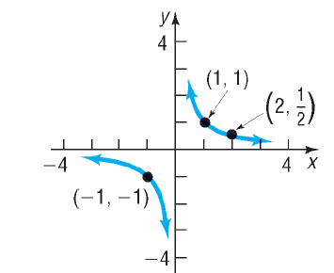
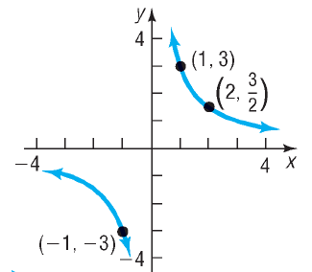



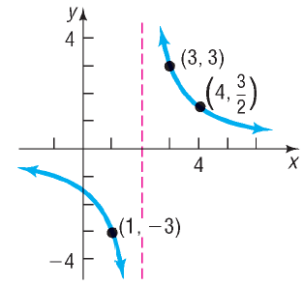





Copyright © 2012 Pearson Education, Inc. Publishing as Prentice Hall.

Slide 25










Copyright © 2012 Pearson Education, Inc. Publishing as Prentice Hall.

